Slide 1
Introduction to the Endocrine System

Slide 2
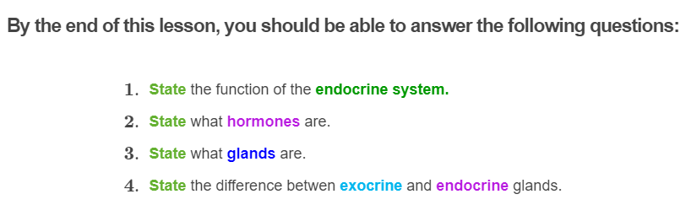


Slide 3
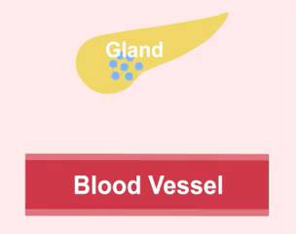
Your nervous system isn't the only system that is involved in controlling bodily function and maintaining homeostasis of the body.
Your endocrine system also has an essential role in maintaining homeostasis of the body!
The endocrine system is made up of a collection of glands which produce and secrete chemicals directly into the bloodstream.

Slide 4
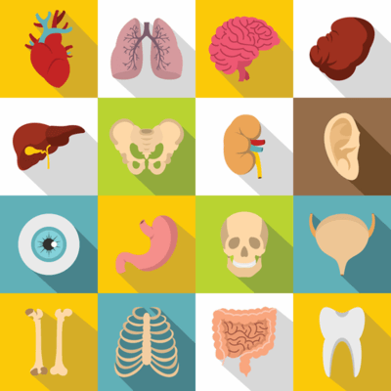
The endocrine system influences almost every cell, organ and function of our bodies.
It plays a huge role in regulating mood, growth, development, tissue function, metabolism, sexual function and reproductive processes.

Slide 5
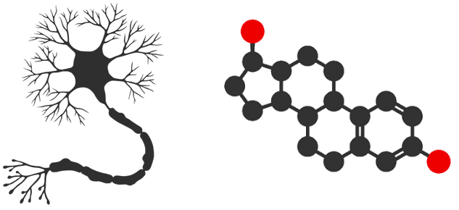
The nervous system communicates information through the use of electrical impulses that are sent through nerve cells.
Electrical signals travel very fast, resulting in a quick response.
However, the endocrine system communicates information through the use of chemical molecules, called hormones, which are transported through the bloodstream. This results in a slow but longer lasting response.

Slide 6

The endocrine system is in charge of body processes that happen slowly.
These include processes such as cell growth, development, metabolism (body energy levels) and results in long lasting effects.
On the other hand, the nervous system provides fast and instant responses like when making voluntary movements.

Slide 7
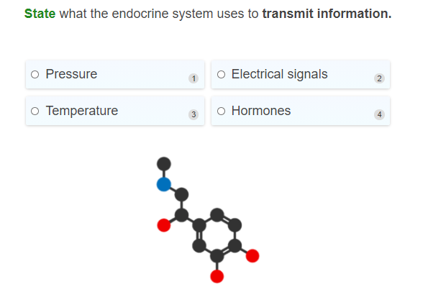

Slide 8
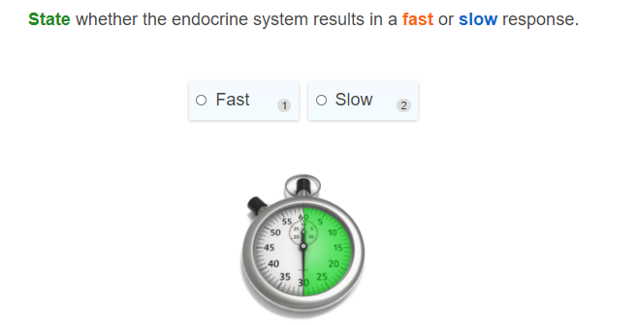

Slide 9
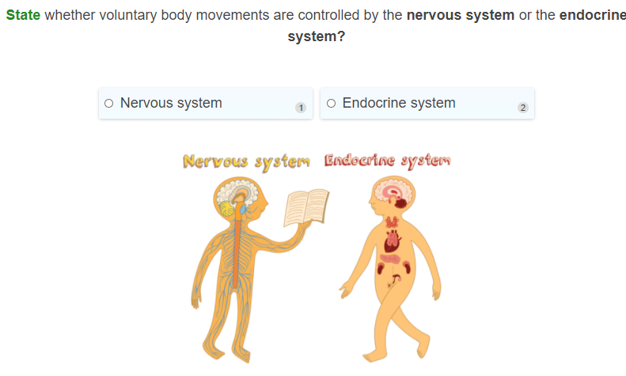

Slide 10
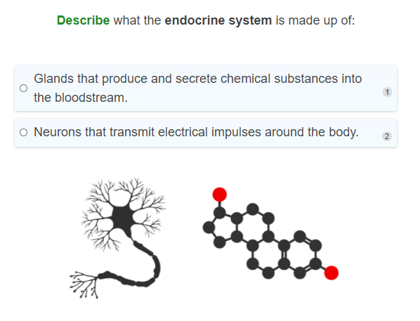

Slide 11
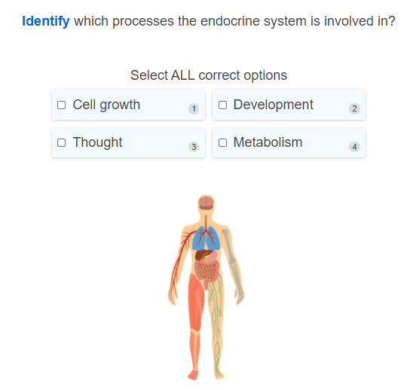

Slide 12
The endocrine system is made up of glands that produce and release chemicals into the bloodstream.
A gland is a group of cells that produces and secretes (releases) chemicals.

Slide 13
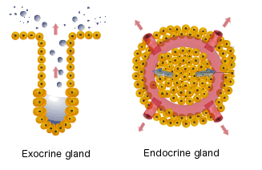
Glands can be divided up into two types:
1. | Exocrine gland
2. | Endocrine gland

Slide 14
Exocrine and Endocrine glands
Exocrine glands, such as the sweat and tear glands, are glands that release their secretions through ducts (a thin tube or passageway) into specific areas of the body, such as in the skin or inside the mouth.
Endocrine glands, are the glands of the endocrine system that secrete hormones directly into the bloodstream where they can be transported to cells in other parts of the body.

Slide 15
The difference between the Exocrine and Endocrine glands
The main difference between these glands is that exocrine glands are secreted through ducts, whereas endocrine glands are secreted straight into the bloodstream.
Only the endocrine glands are part of the endocrine system.

Slide 16
The major glands that make up the endocrine system include the:
• | Pituitary gland | • | Adrenal glands
• | Hypothalamus | • | Thyroid
• | Parathyroids | • | Pineal body
• | Pancreas | • | Reproductive glands (The testes and the ovaries)

Slide 17
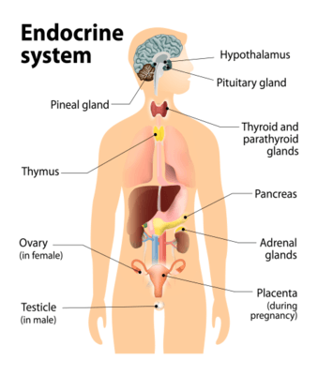
The below picture shows where each gland is located in the human body.

Slide 18
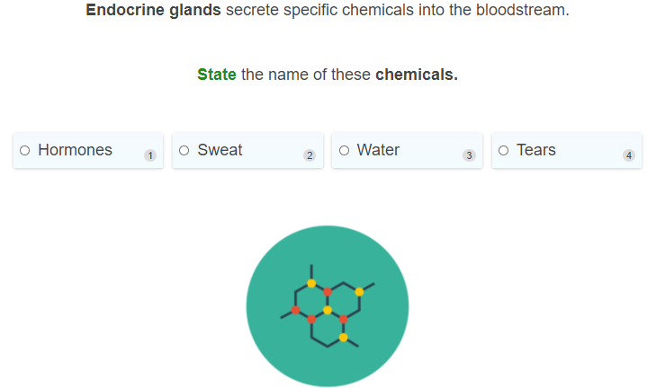

Slide 19
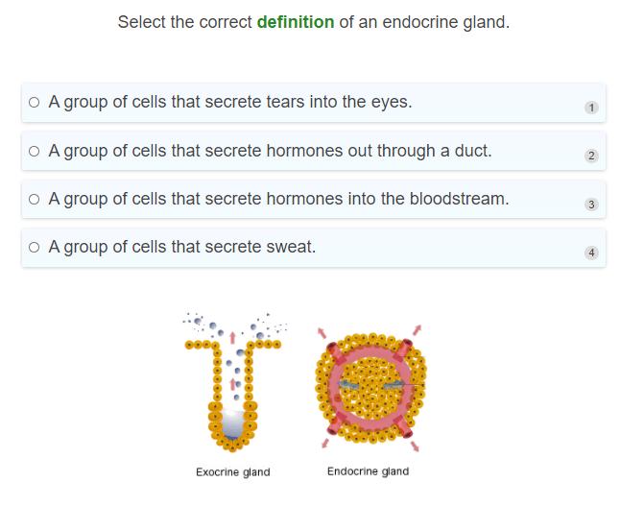

Slide 20
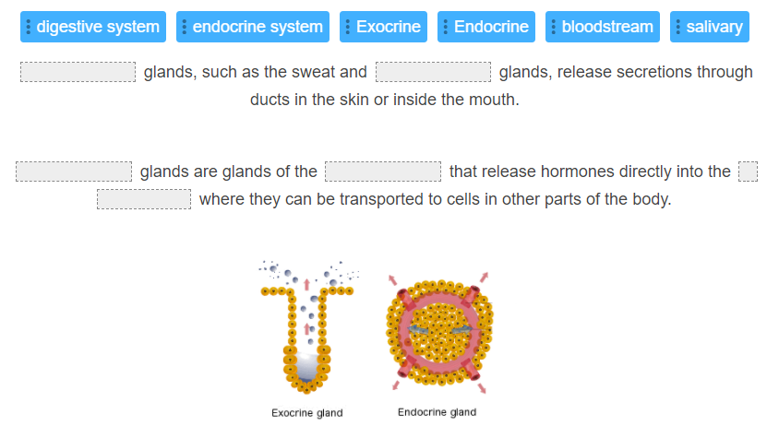

Slide 21
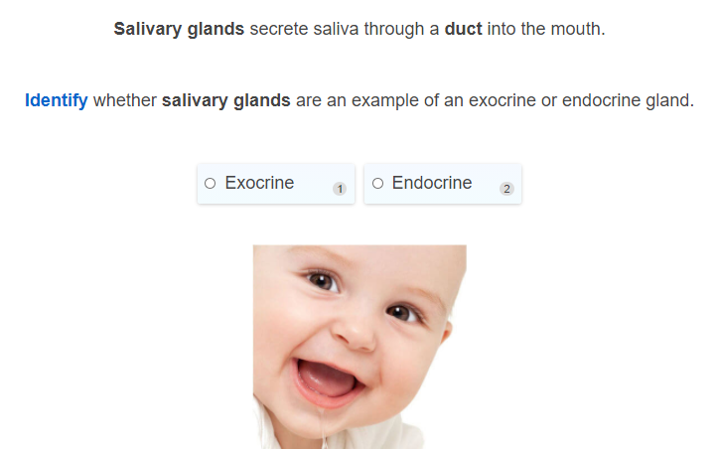

Slide 22
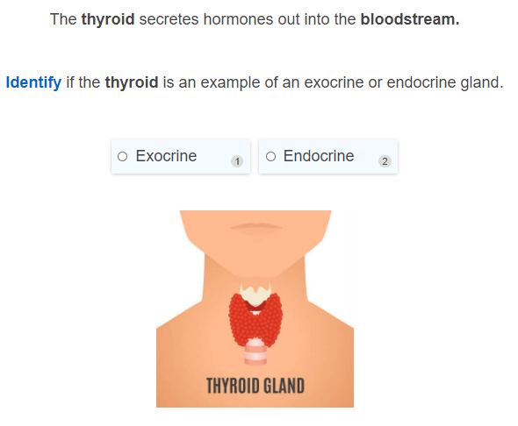

Slide 23
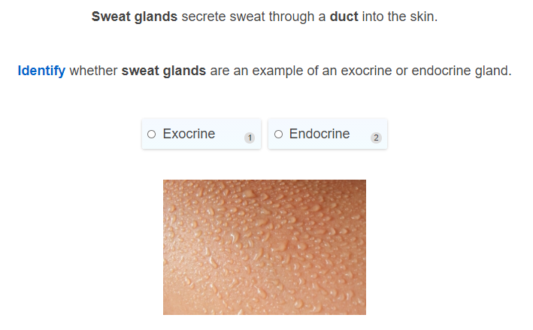

Slide 24
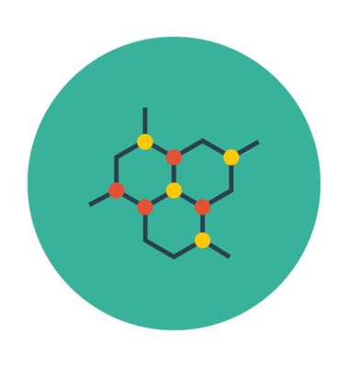
Hormones are chemicals that are produced and secreted (released) from endocrine glands into the bloodstream where it can be transported around the body.
They can then bind to specific cells and command them to do certain things. This makes them little chemical messengers.
Hormones are used to communicate between organs and tissues so that certain bodily functions can be controlled, such as digestion, metabolism, respiration, excretion, growth, development, reproduction, and mood.

Slide 25
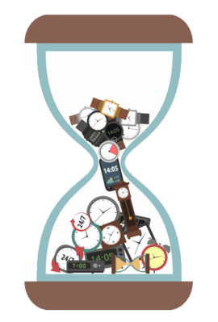
The Endocrine System has slow responses that last a long time.
The reason why responses in the endocrine system occur slowly (responses can occur in minutes, hours or even days) is because it takes time to produce hormones, and for those hormones to travel to where they need to go.
However, the response can last for a long time. This is because the response will continue so long as hormones are in the area, and it takes time to destroy or remove them.

Slide 26
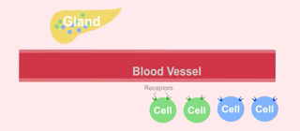
There are many different hormones that move through the bloodstream at the same time, where they can be carried to all parts of the body.
However not all cells will respond to the same hormone.
So how do hormones know which cell to target?

Slide 27
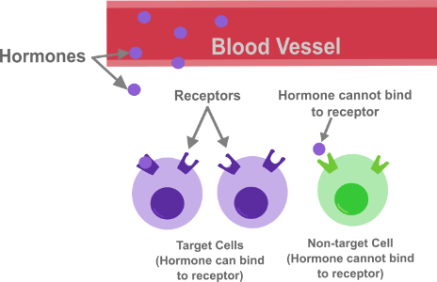
Each type of hormone is designed to target and affect specific cells.
Only particular cells will display a receptor that recognises a specific type of hormone. This ensures that only cells that display the receptor for the particular hormone are affected.
In other words, hormones are receptor-specific.

Slide 28
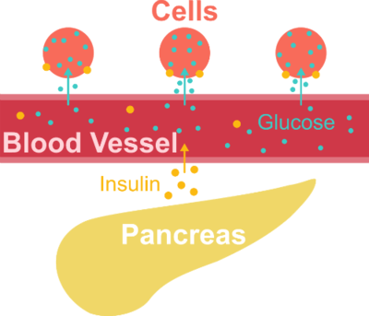
Let's look at an example of the endocrine system in action!
Insulin is a hormone that controls the concentration of glucose (sugar) in the blood. When blood glucose levels rise, such as after eating, an organ called the pancreas secretes insulin into the blood.
The insulin binds to cells and tells those cells to absorb glucose from the blood. This returns blood glucose concentrations to normal levels.

Slide 29
The response produced by insulin is slow and long-lasting.
After blood glucose levels start to rise, it takes several minutes for cells to start absorbing glucose from the blood. The cells will keep absorbing glucose until normal blood glucose levels are restored. This can take over an hour.

Slide 30
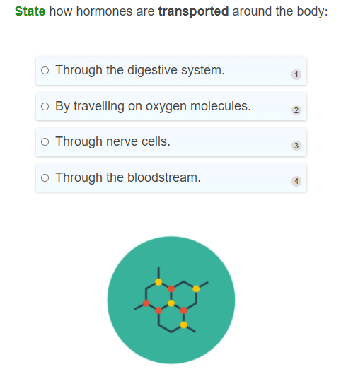

Slide 31
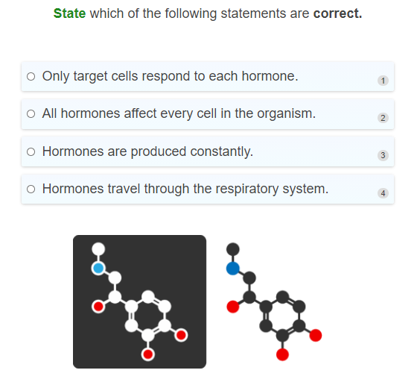

Slide 32
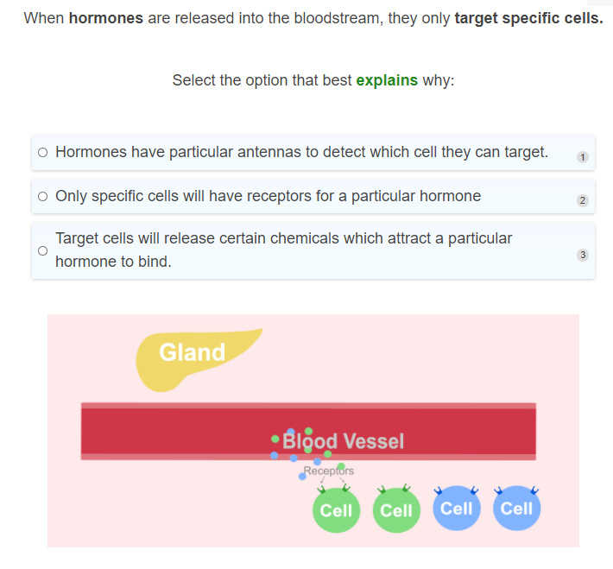

Slide 33
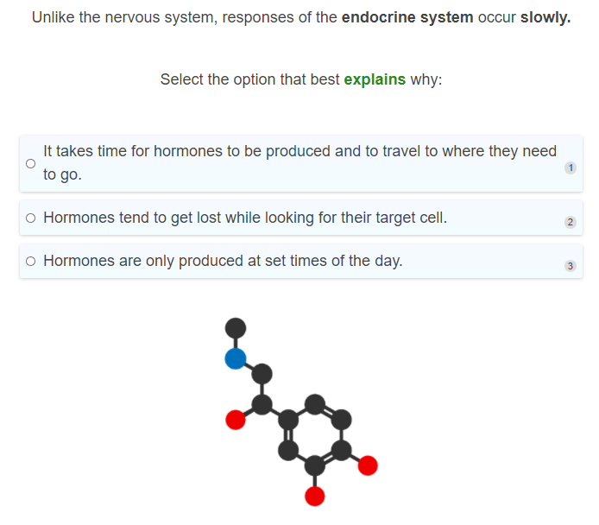

Slide 34
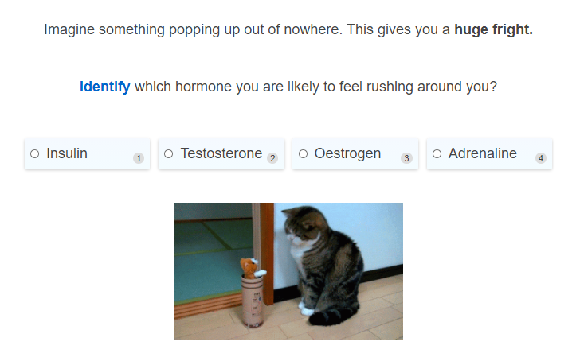

Slide 35
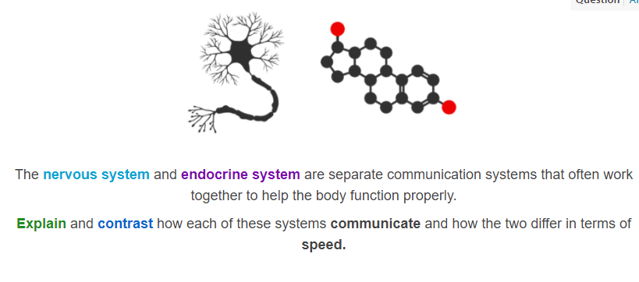

Slide 36
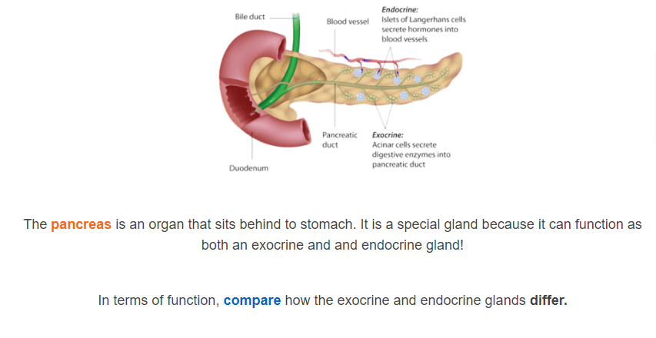

Slide 37
